Slide 1
Can open technology, society, and culture remove barriers to human sharing and create a thriving commons-based future?
Presented by Chris Cormack // 17/4/2015

Slide 2
Who am I?
Kai Tahu, Kati Mamoe, Waitaha
BSc Compsci, BA Maths and Māori Studies
One of the original Koha developers
Working at Catalyst IT
Release maintainer for the 3.18.x branch of Koha

Slide 3

Good grief, how can I answer this?

Slide 4
Titiro whakamuri
Nā tō rourou, nā taku rourou ka ora ai te iwi.
Ehara taku toa i te toa takitahi, engari he toa takitini.
He waka eke noa.
Ma tini ma mano ka rapa te whai.

Slide 5
Mana tangata
“To be a person is not to stand alone, but to be one with one's people, and the deeper the oneness the more we are truly persons and have that mana tangata.”
- Michael P Shirres : 2000

Slide 6
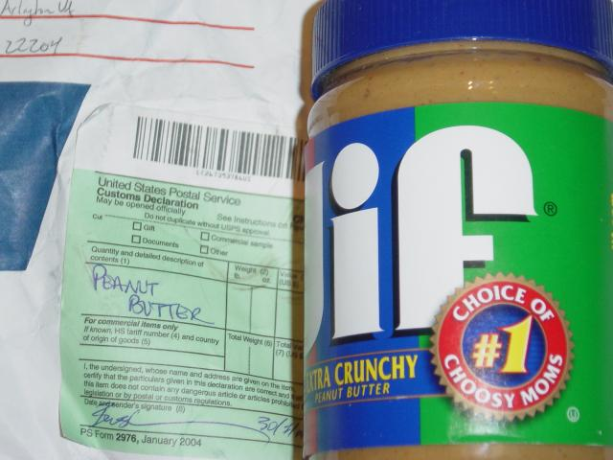
Whakanuia

Slide 7
Kaiakopono
“
“Not everyone needs to be the Welcome Wagon -- but someone ought to be.”
- Esther Schindler : 2009

Slide 8
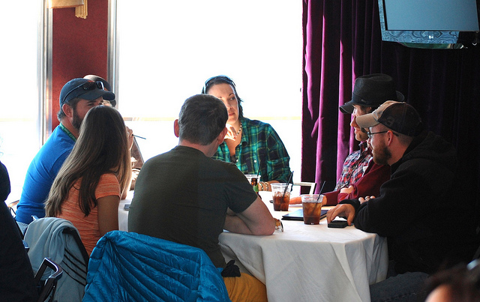
Korerorero

Slide 9
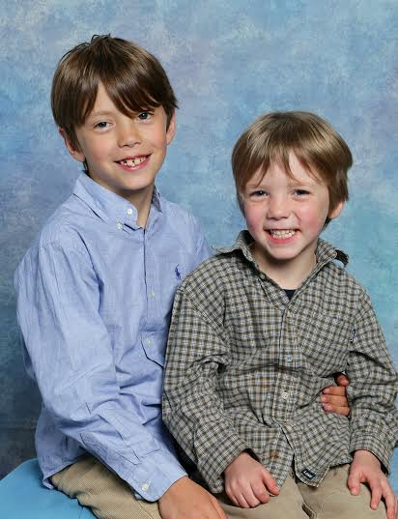
Whakaaro whānui

